Slide 1


Customer Churn Analysis
GROUP 5
Boutique sales products Analysis
Prepared by: VERSAILLES Chrismond
VALCIN Pierry
THIMOTHÉE Djenina

Slide 2
Introduction
The leading telecom company has a massive market share but one big problem: several rivals that are constantly trying to steal customers.
Because this company has been the market leader for so many years, there are not significant opportunities to grow with new customers.
Instead, Company executives have decided to focus on their churn: The rate at which they lose customers.
They contacted us to solve this problem and help the marketing team and the customer service team develop new strategies to retain customers.

Slide 3
Churn Analysis
Churn analysis is the evaluation of a company’s customer loss rate in order to reduce it. Also referred to as customer attrition rate, churn can be minimized by assessing your product and how people use it.

Slide 4
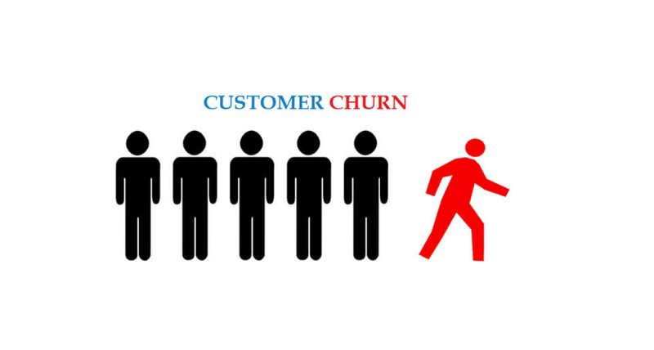
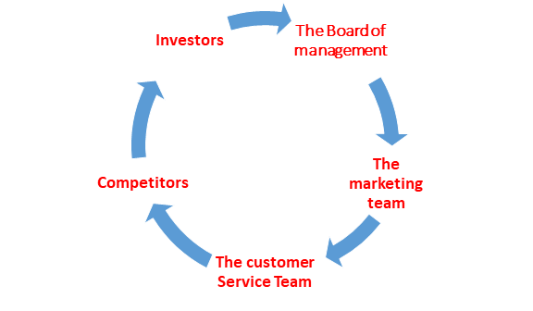
Problem
The problem our client is facing is that they are experiencing high customer churn and there are no significant opportunities for growth with new customers.
The stakeholders impacted are:

Slide 5
Methodology
To realized this project, we used:
The Telecom Company Dataset
Data processing using Python
- Cleaning Data
- Data transformation
- Statistical Analysis
Results (Summary Statistics)
Slideshow made by Powerpoint
Four optimal solutions were found

Slide 6
Result
1 . - Churn

Slide 7
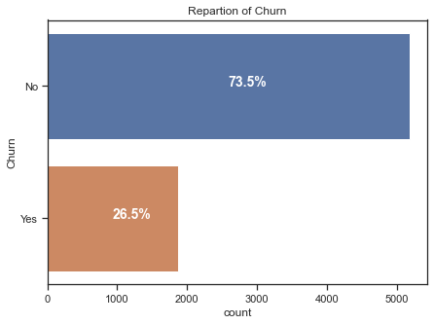
The impact of Churn
Compared to the existing base customer, Churners represent about 26.5%.
That's 1,869 customers who changed their minds in the last month.

Slide 8
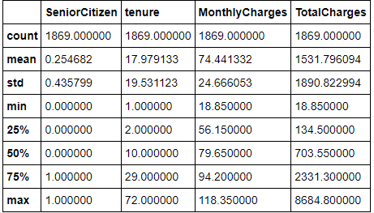
Informations about the customers who have churned.
The mean of subscription month of a client who has churn is about 18 months and 50 percent of these clients has been around for less than 10 months
On average , a client pays 74.44 dollars /month for a subscription . The minimum monthly charges is 18.85 dollars and 50 percent of the client pays more than 79.65 dollars
One of the clients that have churned paid 8684.8 dollars in total charges and 25 percent of the clients pays more than 2331.3 dollars in charges

Slide 9
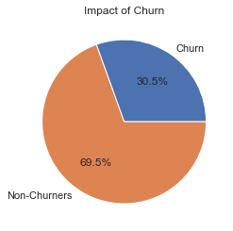
How much is churn affecting the business?
Based on all customer data, customers who have unsubscribed account for approximately $139130.85 (30.5%) of the company's total revenue.

Slide 10
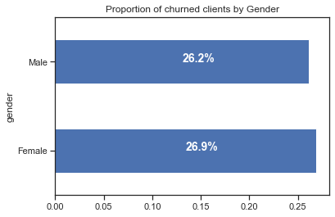
Proportion of churned clients by GENDER
Gender
There is no big difference in the distribution of churn by gender. Both genders churn at the same Rate.

Slide 11
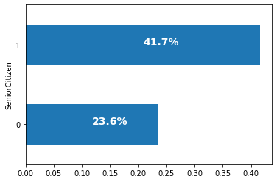
Proportion of churned clients by Age Group.
Age Group
Senior citizen is binary and really significant 41,7% of the senior citizens have churn.

Slide 12
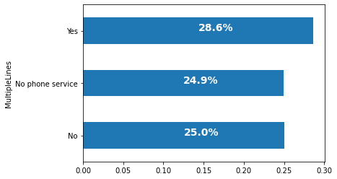
Proportion of churned clients BY SERVICES USED
MultipleLines Service
28.6% of the people that had multiple lines have churned and for those who do not have telephone service or otherwise do not use the multiple lines represent about 24,9%.
We can affirm that a client having multiple phoneline or no phone service at all churn at the same rate.

Slide 13
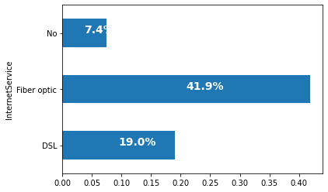
DISTRIBUTION OF CHURN BY SERVICES USED
Internet Service
41. 9% of the client that used fiber optic churned which is significant compared to other internet services.
A customer having access to that services is likely to churn. The company must focus on this services.

Slide 14
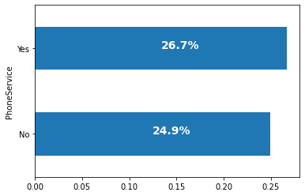
DISTRIBUTION OF CHURN BY SERVICES USED
Phone Service
The phone service is very used but among those who have churned there is not a significant difference if they had access to this service or not.

Slide 15
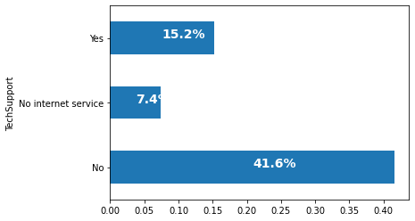
DISTRIBUTION OF CHURN BY SERVICES USED
Tech Support
It is pretty obvious that people who didn’t have access to Technical Support churned more often.
But still 15,2% of the client that chooses tech support churned.

Slide 16

DISTRIBUTION OF CHURN BY SERVICES USED
Online Security
41,8% of people who had no access to online security churned the past month.
And still 14,6% of the people that had access to online Security Churned

Slide 17
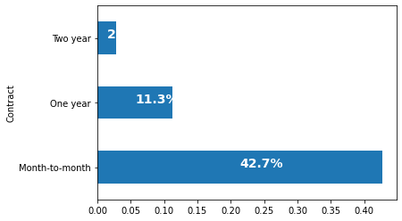
DISTRIBUTION OF CHURN BY TYPE OF CONTRACT
Contract
Here , This graph is showing us that 42,7% of the people that had a month to month contract cancel their subscriptions.

Slide 18
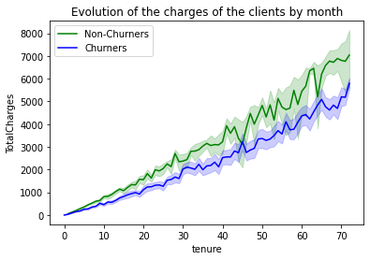
-Evolution of the charges
Looking at this line Graph, We can affirm that Non-churners tends to pay higher fee for their subcription at the company.
This could be a reason why they are churning.

Slide 19
Discussion & Proposal Solutions
Solution 1: Building Churners profiles using Machine Learning Algorithms
Strength | Weakness
Speed Scale Efficiency | Lack of inspectability Cold start Blind to connections in data
Opportunities | Threats
Opportunity for the telecommunication company to be one step ahead and be probable to churn. Opportunity for the telecommunication company to have a defense system that evolves and adapts . It will help prevent churn. | - There is always a risk due to bias, the time it takes to adapt our program and the lack of human expertise.

Slide 20
Discussion & Proposal Solutions
Solution 2: Reduce the price of support services
Strengths | Weaknesses
Its implementation time It will be easier to monitor and address recurring problems. | - Reduces the profit margin on these services. - Support services are not the priority services for customers.
Opportunities | Threats
- The company can not only keep its customers but also attract new ones. - Develop a new advertising campaign about adapting its services to all budgets. | - These services may not be profitable for the company as the risk of loss on these services increases with the reduced price. - If the support services are not up to scratch, due to the fact that they are not a priority, the customers can always abandon the company despite the price reduction.

Slide 21
Discussion & Proposed Solution
Alternative solutions: Improve The Internet Connectivity
Many of the customers who churned had internet service, which is why we should increase the quality of internet services, especially fiber optics.

Slide 22
Discussion & Proposed Solution
Alternative solutions: Favour relatively long contracts
The customers with short contracts churned the most. By favoring long contracts ,we will have more time to anticipate the departure of the customer on the one hand and on the other hand the customer will have time to familiarize and appreciate as it should, the services that are offered.

Slide 23
How long will it take for the company to lose all its customers? Which demographics will they lose first?
Telco had a base of 7043 customers of which 26.5% have churned and if the company does nothing and the customers continue to churn at the same rate the company will lose all its customers within 29 months.

Slide 24
References & Appendices
Customer Churn Analysis
- Data: https://www.kaggle.com/blastchar/telco-customer-churn/data#
- The jupyter notebook is attached along with this powerpoint presentation.

Slide 25
THANKS
Contact Me
I you have any question about this presentation, Feel free to send us a message in the #business-analysis channel on slack.
Ressources
See the full project

